Slide 1

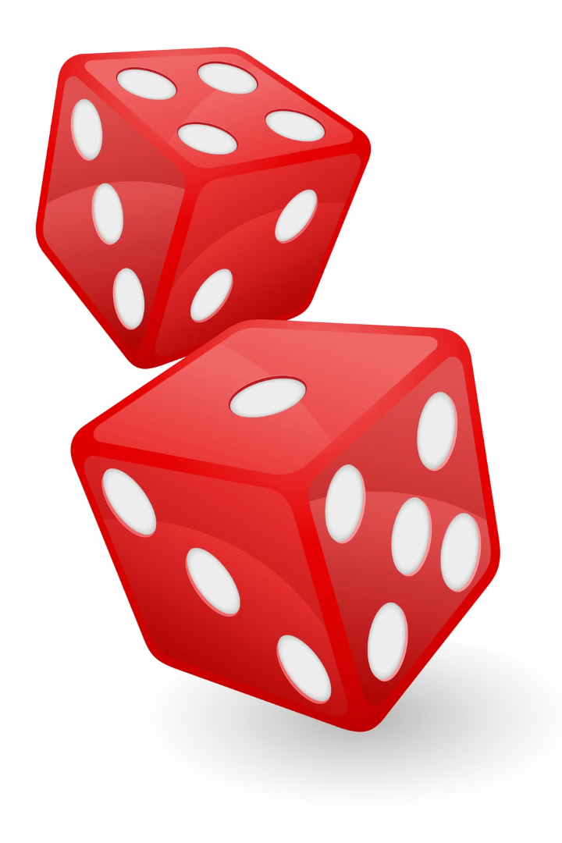
Dice Game Project
By
Batch - 1
Team Members :
Ria – 22UP1A1201
Sravanthi – 22UP1A1223
Trishitha – 22UP1A1224
Charitha – 22UP1A1236
Prasanna – 22UP1A1239
Radhika – 22UP1A1258

Slide 2
Game Mechanics
1
2
3
Roll the Dice
Score Calculation
Winning Condition
The player clicks a button to simulate rolling a pair of dice. The dice values are randomly generated.
The game calculates the score of the dice roll and displays it to the player.
The game can be set up with different winning conditions. For example, the player could win by rolling the higher number or by achieving a certain total score within a set number of rolls.

Slide 3

HTML Structure
Dice Display
Score Display
Roll Button
This section will contain images representing the dice. We'll use two images to represent the two dice that the player rolls. These images will be dynamically updated with the result of each roll using JavaScript.
The score display area will show the player's current score. It will be updated after each dice roll.
The roll button will trigger the dice roll action. When the player clicks this button, the JavaScript code will generate random dice values and update the display.

Slide 4
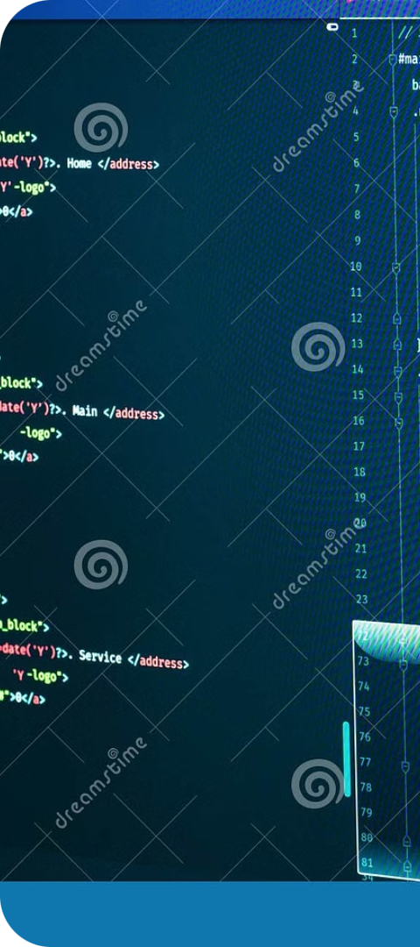
CSS Styling
1
Dice Visuals
2
Button Design
Using CSS, we can style the appearance of the dice. We can choose the color, size, and design of the dice images to create a visually appealing and thematic game experience.
We can customize the appearance of the roll button with colors, fonts, and borders to match the overall theme of the game.
3
Layout and Positioning
CSS will help us arrange the dice, score display, and roll button in a visually pleasing layout on the game screen. We can also add background images and other decorative elements using CSS.

Slide 5
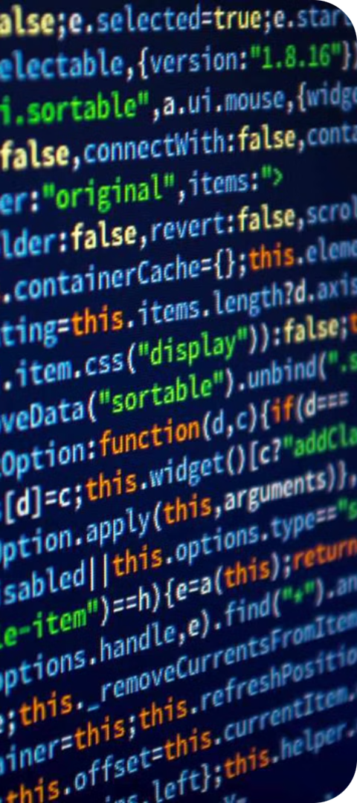



JavaScript Functionality
Dice Roll Logic
The JavaScript code will handle the dice roll functionality. It will generate random numbers between 1 and 6 to represent the dice values.
Score Update
The JavaScript will calculate the total score of the dice roll and update the score display area in the HTML.
Winning Condition Check
The JavaScript will check if the player has met the winning condition. If so, it will display a winning message or proceed with further game logic, such as allowing the player to continue playing.

Slide 6
